Slide 1



Graduation IN Informatics engineering
Flowchart Exploration and Implementation
■ Course Unit: Project III
Luis Alonso 17506
■ Coordinator: Prof. Doctor Jorge Ribeiro
Instituto Politécnico de Viana do Castelo
Escola Superior de Tecnologia e Gestão
www.ipvc.pt
School Year: 2020/2021

Slide 2
Graduation IN Informatics engineering
■ 1. Introduction and Objectives
Project III
Research about Data Flow Diagrams.
Various Data Flow Diagram Tools and Libraries.
Implementation of the Data Flow Diagrams in the context of the Eindhoven Classification Method.
@2020/2021 – Luís Alonso – Flowchart Exploration and Implementation
- 2 -

Slide 3

Graduation IN Informatics engineering
■ 2. Tools and Libraries
Project III
mxGraph is a JavaScript diagramming library that enables interactive graph and charting applications to be quickly created that run natively in any major browser that is supported by its vendor.
@2020/2021 – Luís Alonso – Flowchart Exploration and Implementation
- 3 -

Slide 4
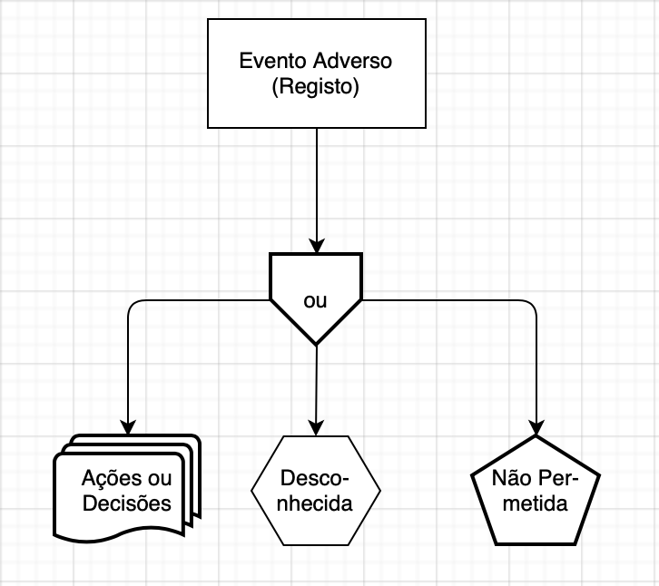
Graduation IN Informatics engineering
■ 2.1 mxGraph Example with Eindhoven Classification Method
Project III
@2020/2021 – Luís Alonso – Flowchart Exploration and Implementation
- 4 -

Slide 5
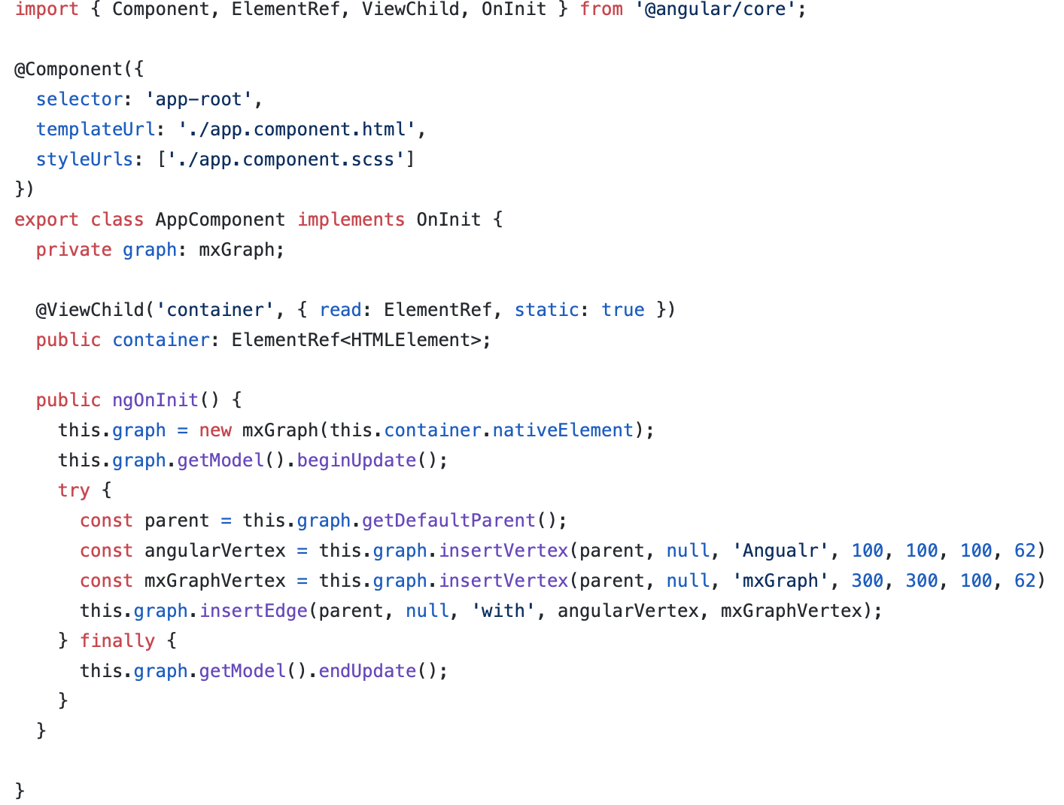
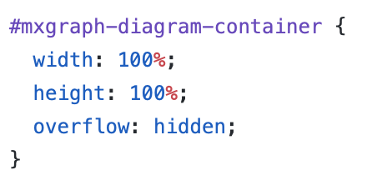
Graduation IN Informatics engineering
■ 2.1- MxGraph on Angular
Project III
MxGraph on Angular
@2020/2021 – Luís Alonso – Flowchart Exploration and Implementation
- 5 -

Slide 6

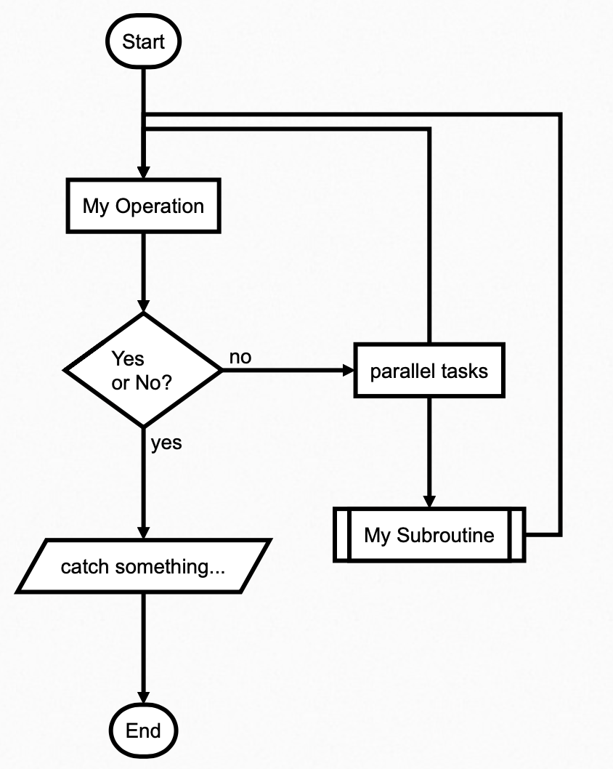
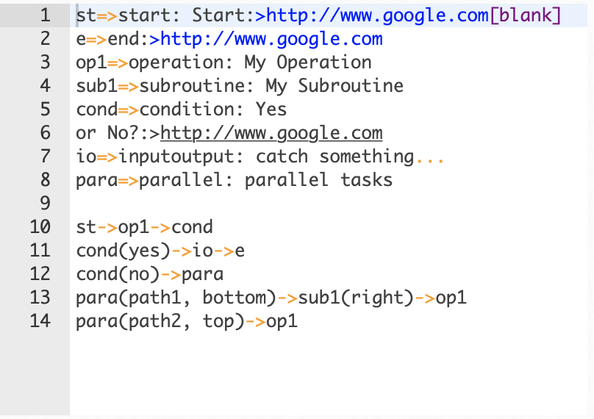
Graduation IN Informatics engineering
■ 2.2- Flowchart.js
Project III
@2020/2021 – Luís Alonso – Flowchart Exploration and Implementation
- 6 -

Slide 7
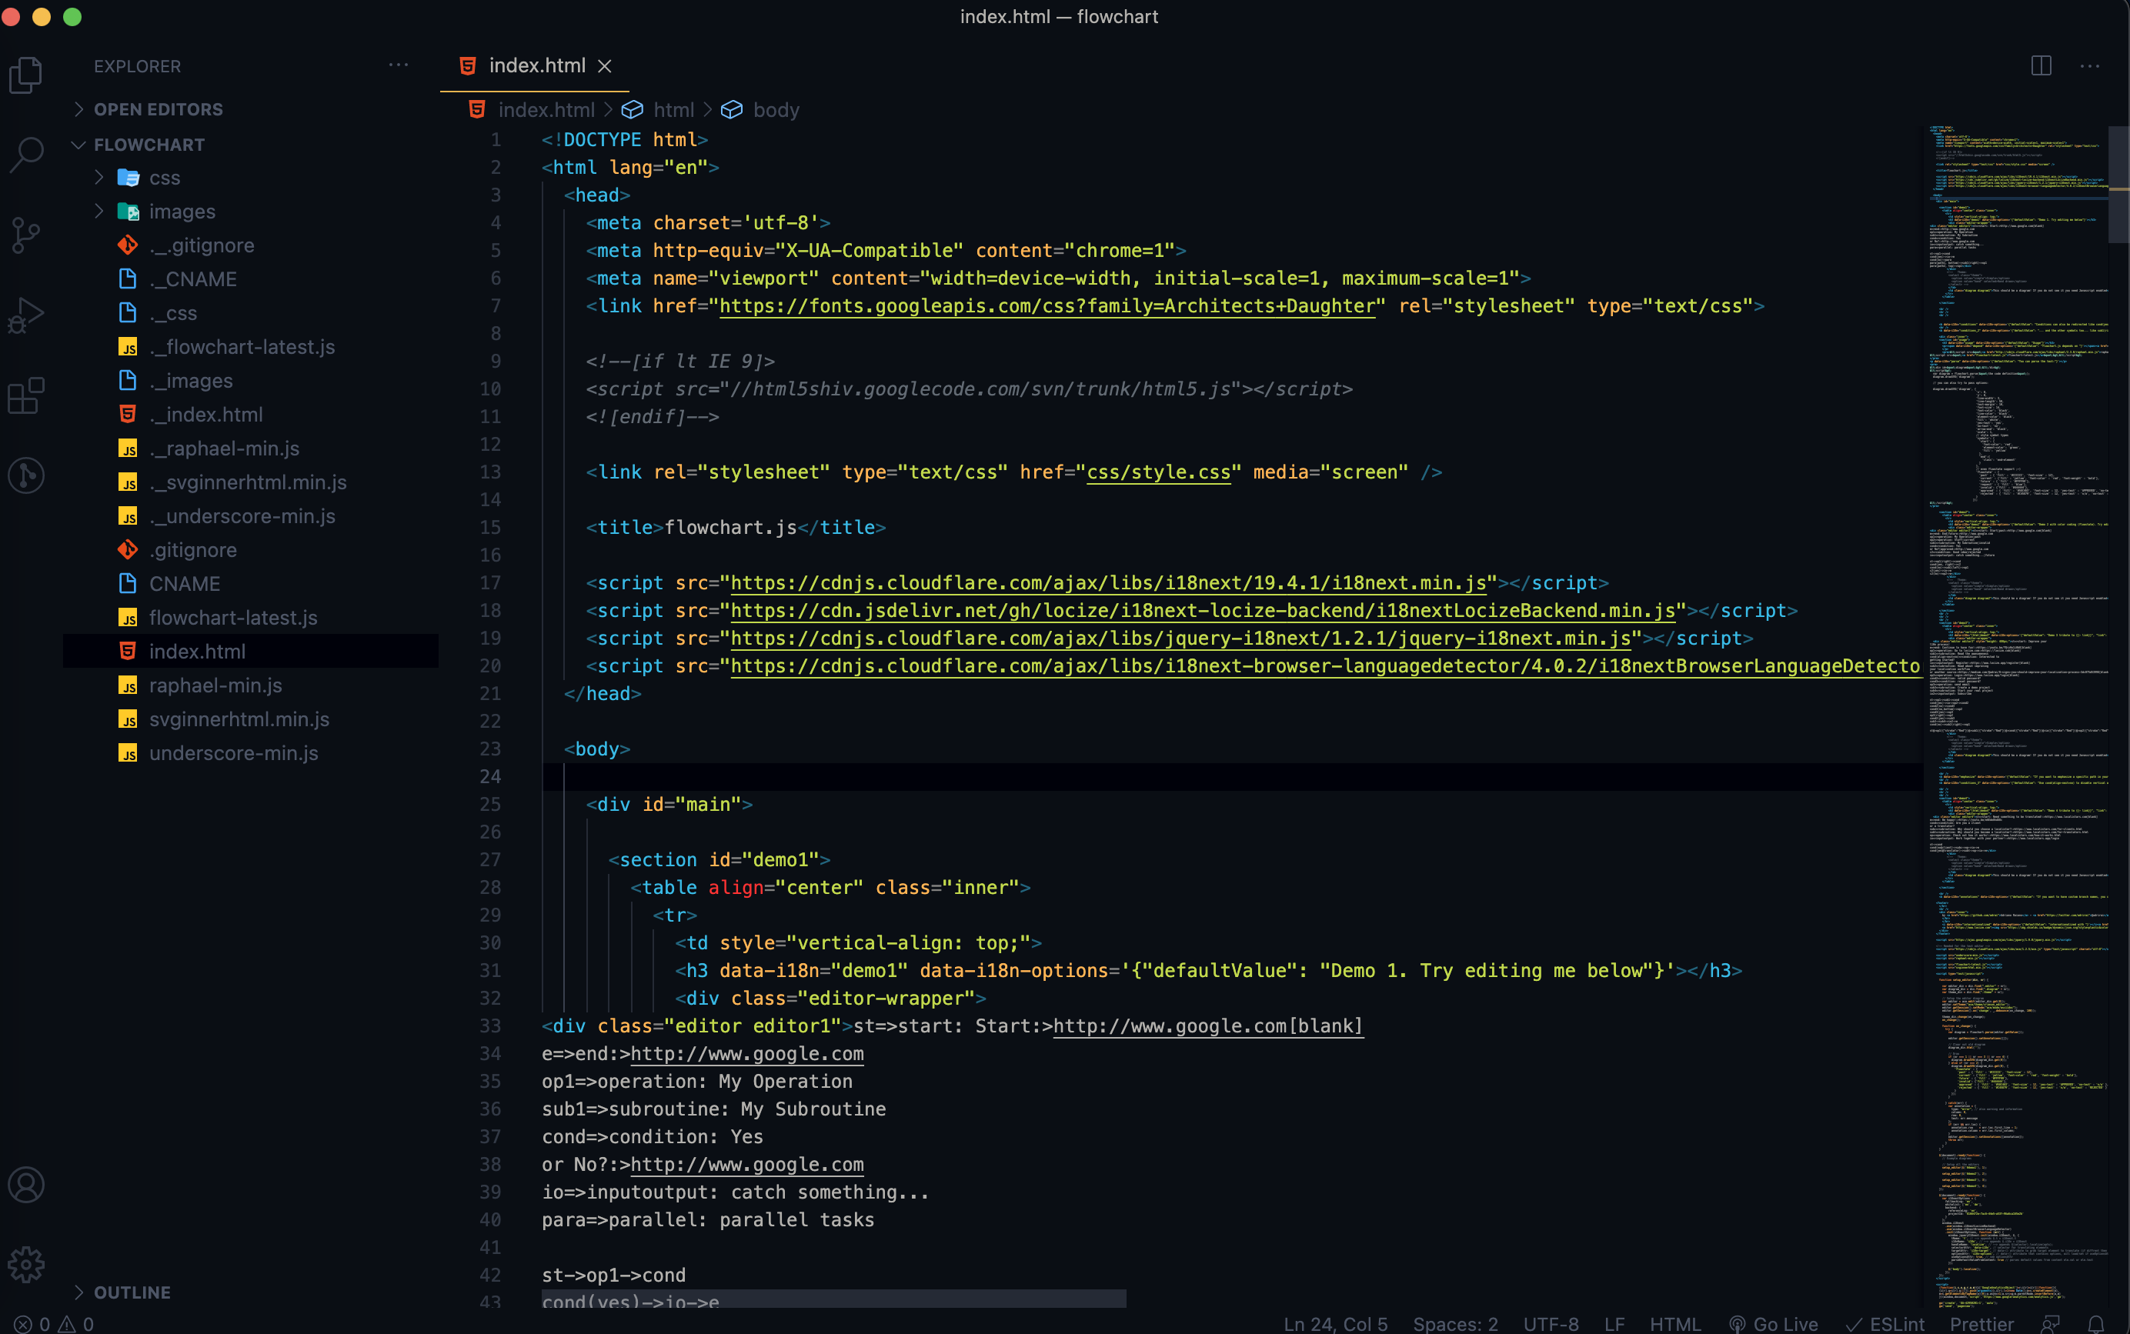
Graduation IN Informatics engineering
■ 2.2- Flowchart.js
Project III
Necessary scripts to use: locize, jquery.
@2020/2021 – Luís Alonso – Flowchart Exploration and Implementation
- 7 -

Slide 8
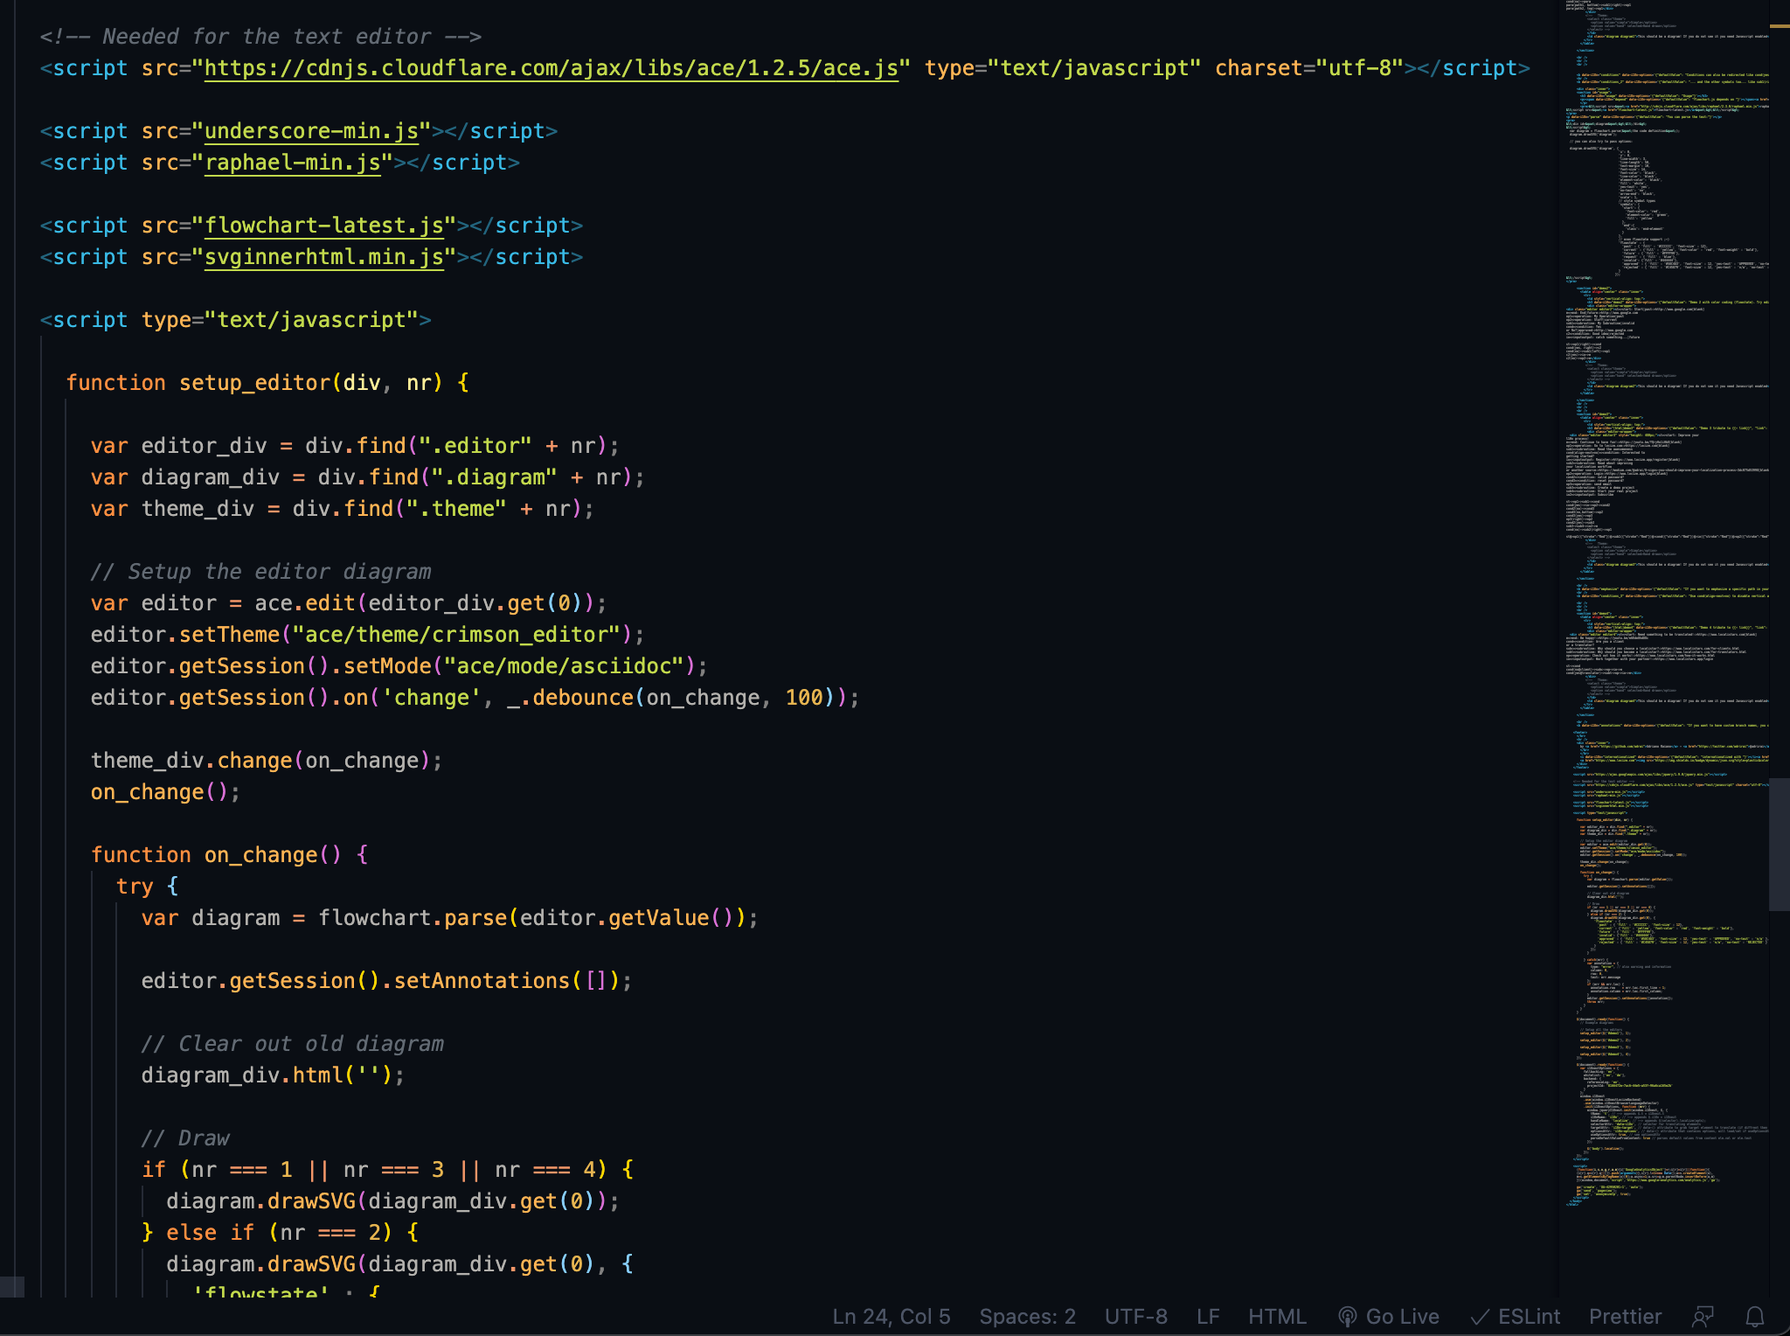
Graduation IN Informatics engineering
■ 2.2- Flowchart.js
Project III
For the text editor we need Raphael, ace.js and svginnerhtml
@2020/2021 – Luís Alonso – Flowchart Exploration and Implementation
- 8 -

Slide 9
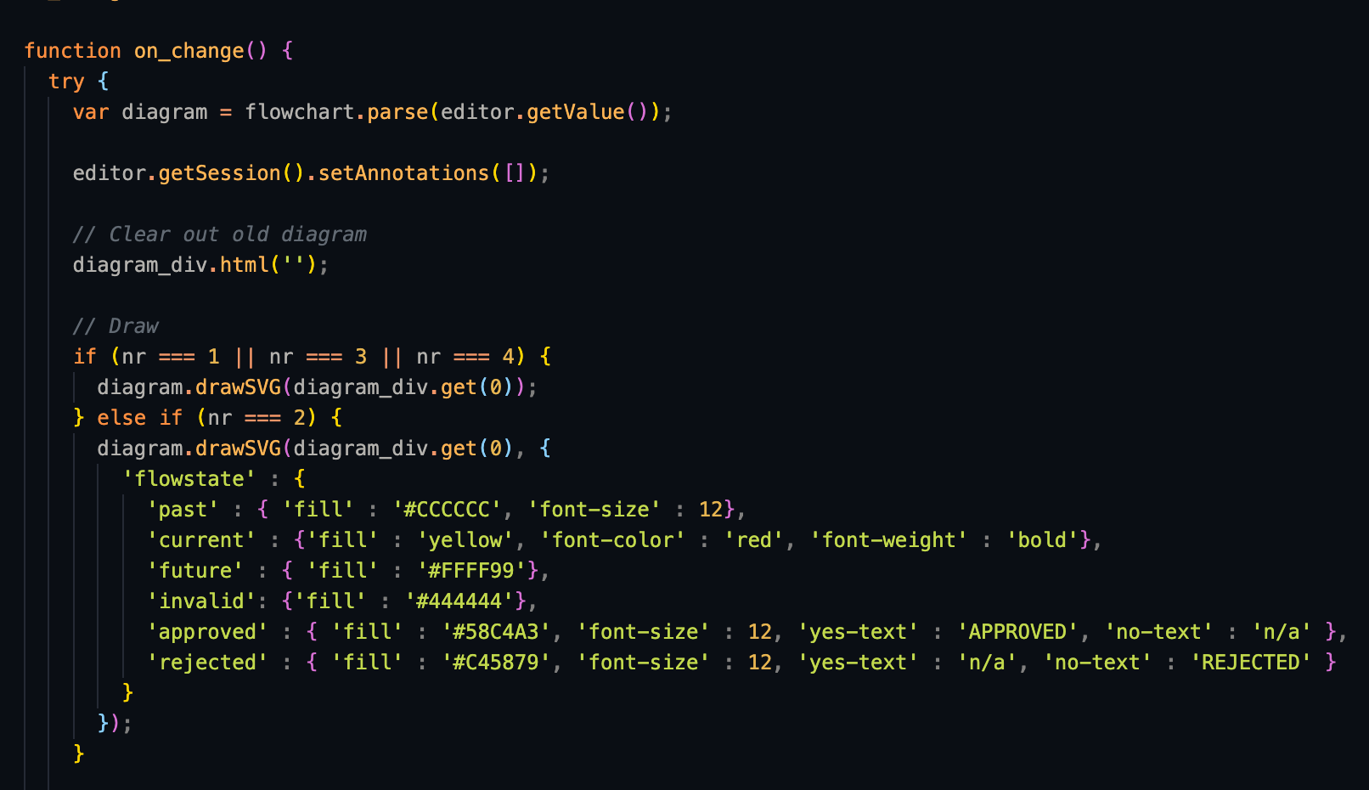
Graduation IN Informatics engineering
■ 2.2- Flowchart.js
Project III
Draw on edit component.
@2020/2021 – Luís Alonso – Flowchart Exploration and Implementation
- 9 -

Slide 10
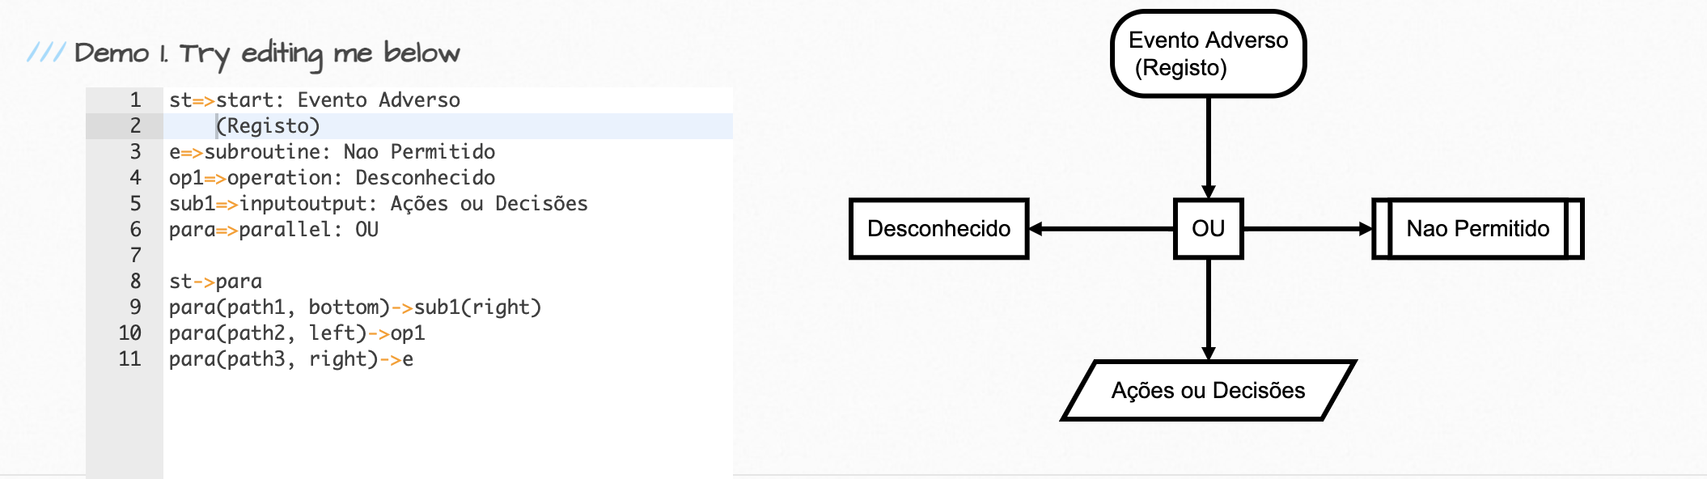
Graduation IN Informatics engineering
■ 2.2- Flowchart.js
Project III
With the Eindhoven Example
@2020/2021 – Luís Alonso – Flowchart Exploration and Implementation
- 10 -

Slide 11
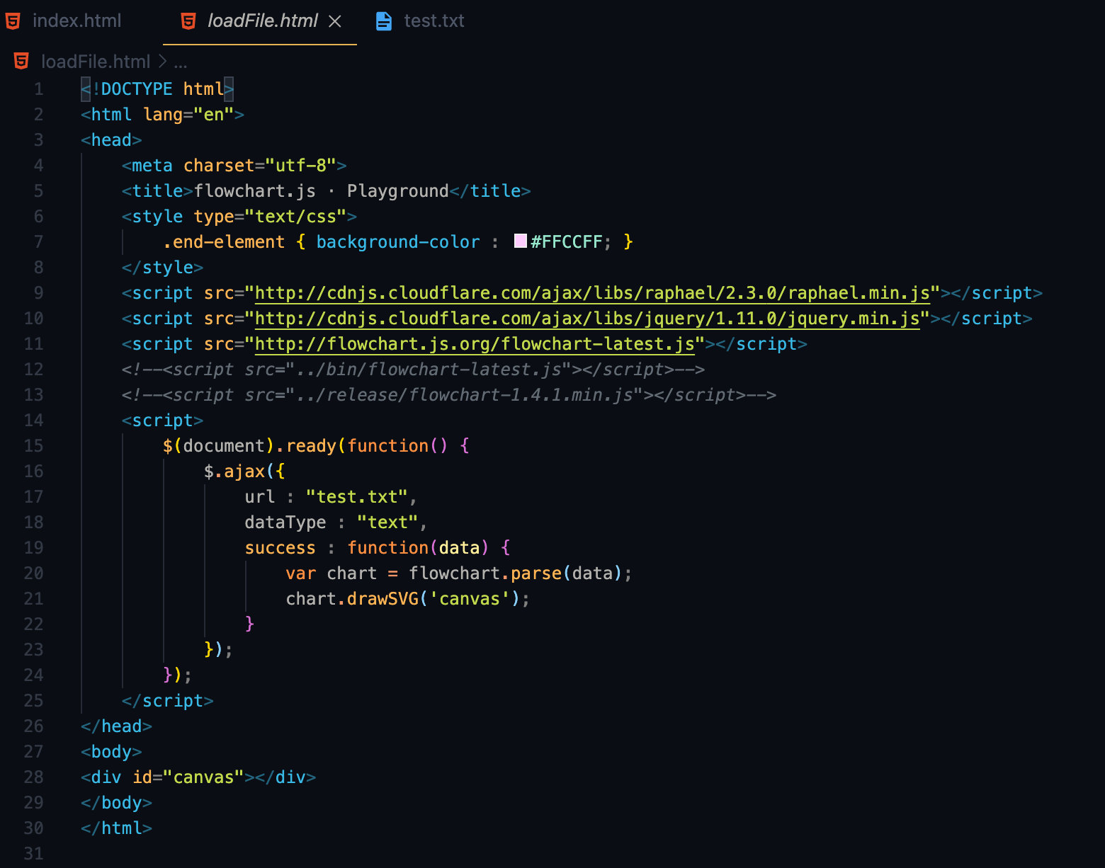
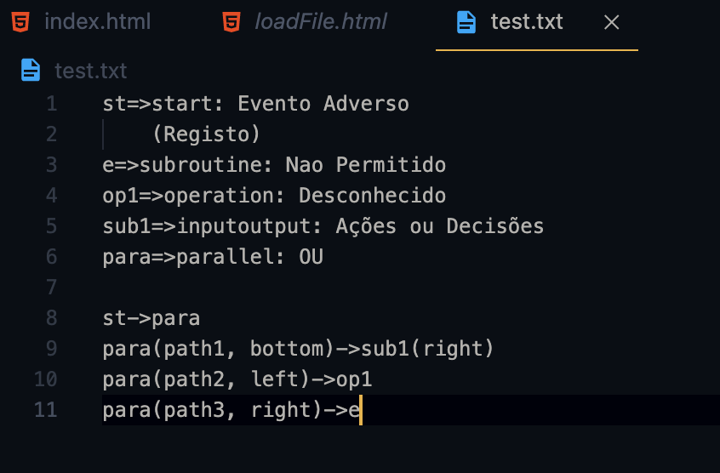
Graduation IN Informatics engineering
■ 2.2- Flowchart.js
Project III
Loading the graph from a text file.
@2020/2021 – Luís Alonso – Flowchart Exploration and Implementation
- 11 -

Slide 12
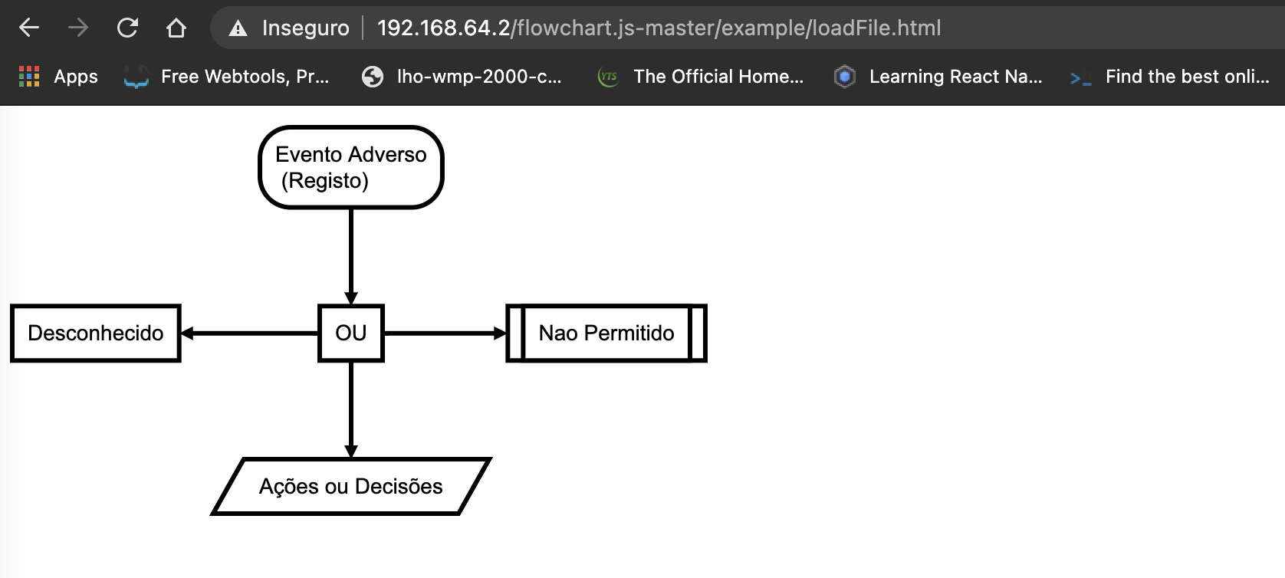
Graduation IN Informatics engineering
■ 2.2- Flowchart.js
Project III
Output
With the Eindhoven Example
@2020/2021 – Luís Alonso – Flowchart Exploration and Implementation
- 12 -

Slide 13
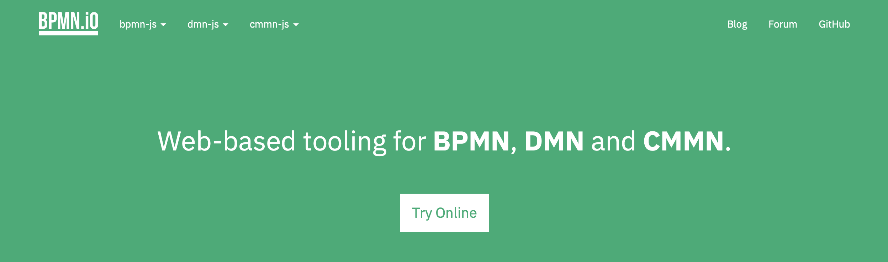
Graduation IN Informatics engineering
■ 2.3- BPM.IO
Project III
@2020/2021 – Luís Alonso – Flowchart Exploration and Implementation
- 13 -

Slide 14
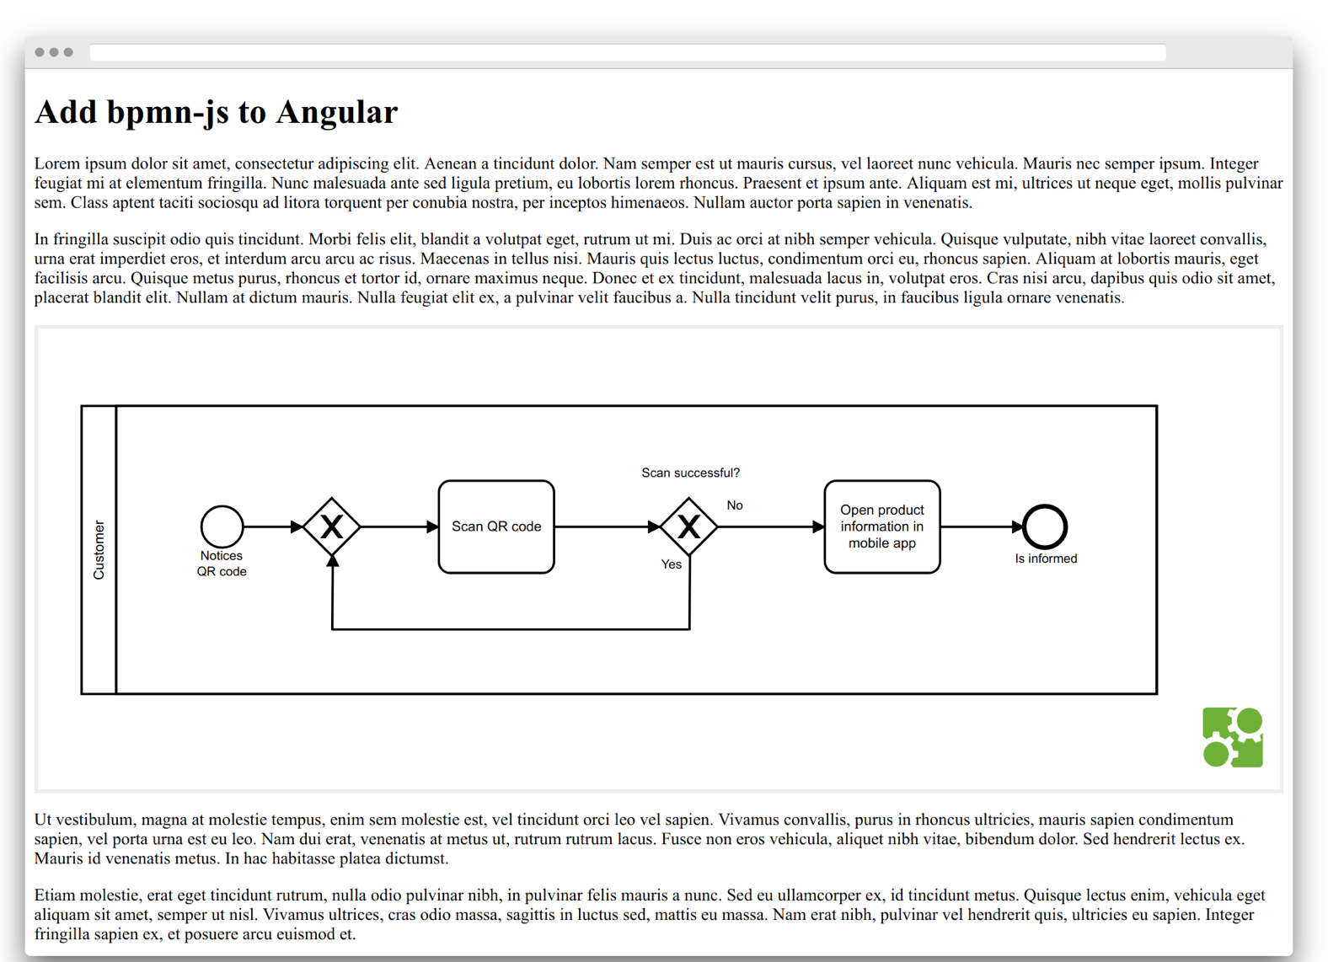
Graduation IN Informatics engineering
■ 2.3- BPM.IO
Project III
@2020/2021 – Luís Alonso – Flowchart Exploration and Implementation
- 14 -

Slide 15
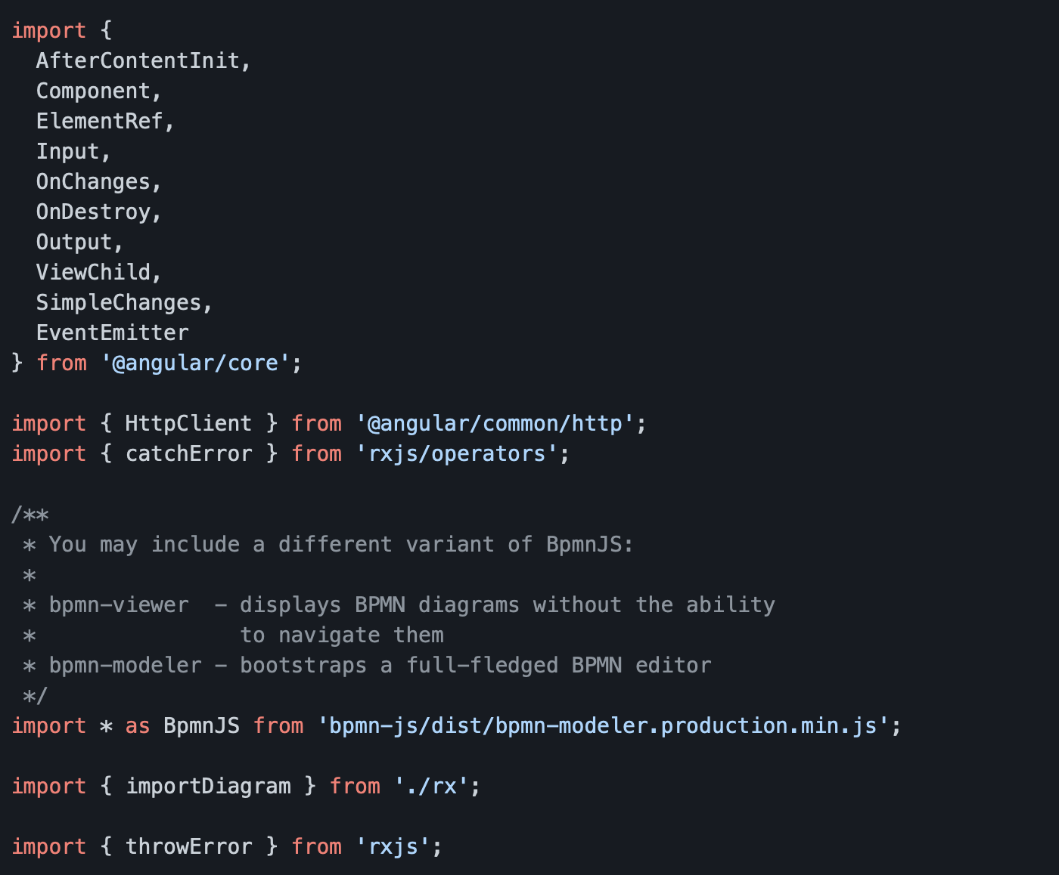
Graduation IN Informatics engineering
■ 2.3- BPM.IO
Project III
@2020/2021 – Luís Alonso – Flowchart Exploration and Implementation
- 15 -

Slide 16
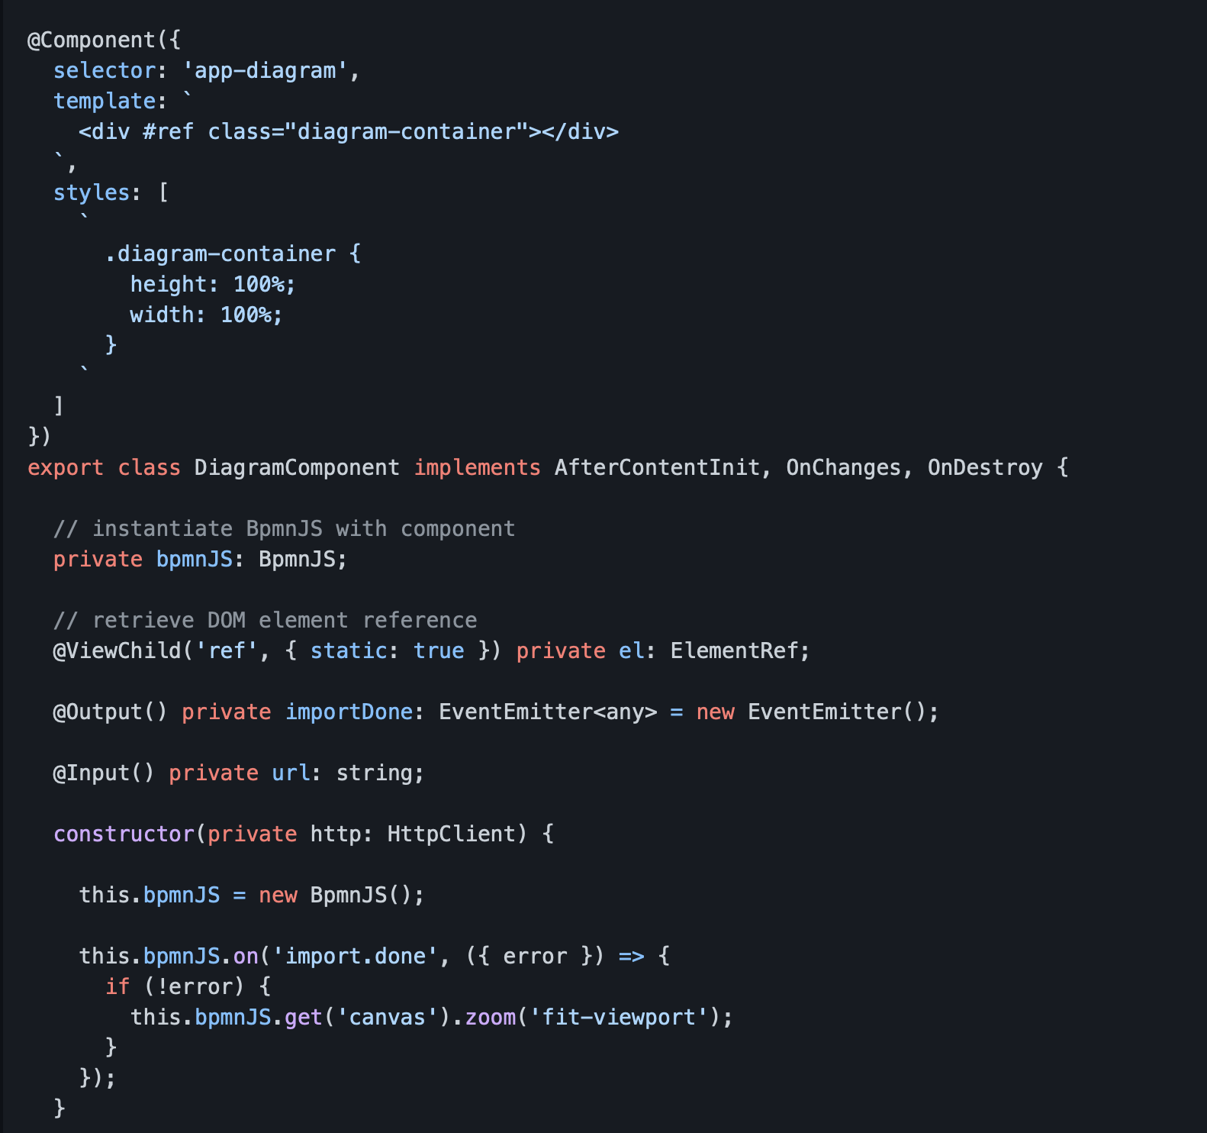
Graduation IN Informatics engineering
■ 2.3- BPM.IO
Project III
@2020/2021 – Luís Alonso – Flowchart Exploration and Implementation
- 16 -

Slide 17
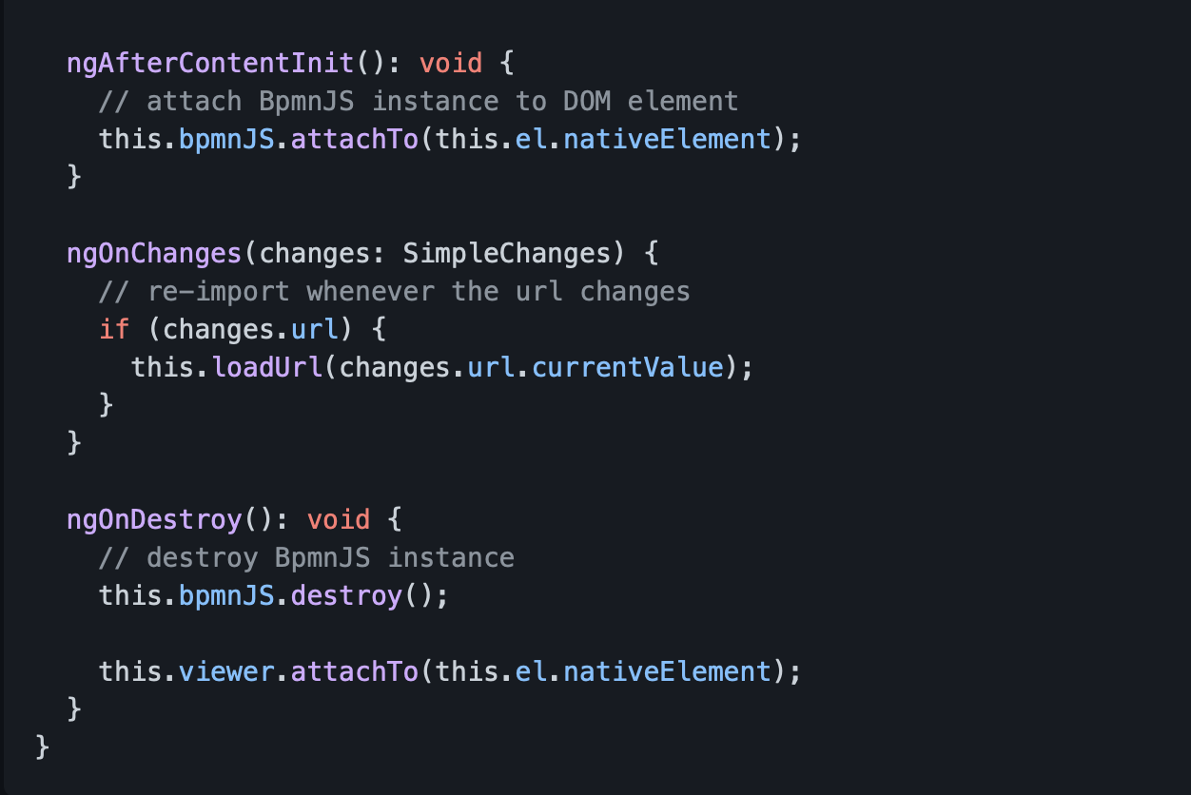
Graduation IN Informatics engineering
■ 2.3- BPM.IO
Project III
@2020/2021 – Luís Alonso – Flowchart Exploration and Implementation
- 17 -

Slide 18
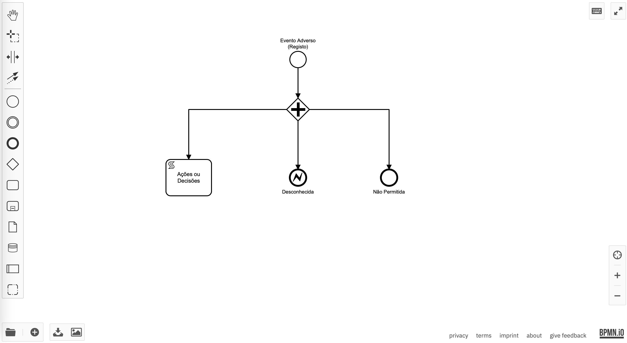

Graduation IN Informatics engineering
■ 2.3- BPM.IO
Project III
It allows to download as SVG, and also import
@2020/2021 – Luís Alonso – Flowchart Exploration and Implementation
- 18 -

Slide 19
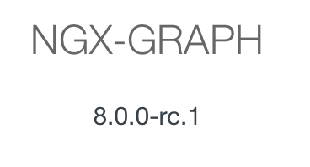
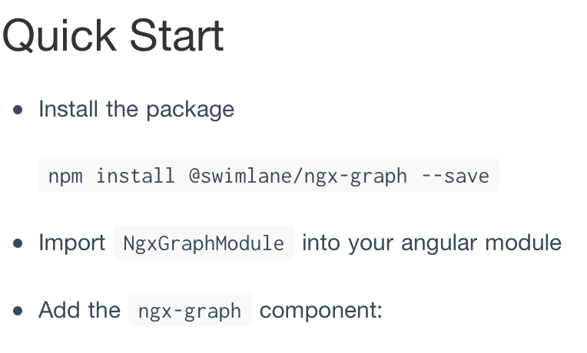
Graduation IN Informatics engineering
■ 2.4- NGX-GRAPH
Project III
@2020/2021 – Luís Alonso – Flowchart Exploration and Implementation
- 19 -

Slide 20
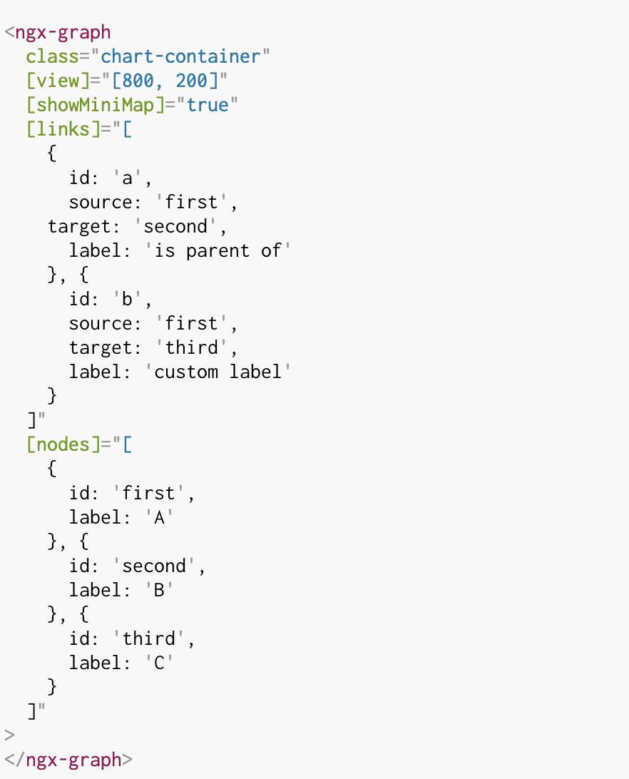
Graduation IN Informatics engineering
■ 2.4- NGX-GRAPH
Project III
@2020/2021 – Luís Alonso – Flowchart Exploration and Implementation
- 20 -

Slide 21
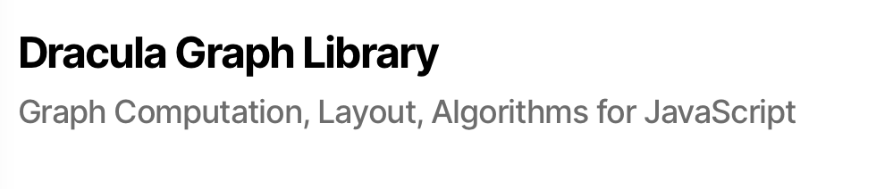
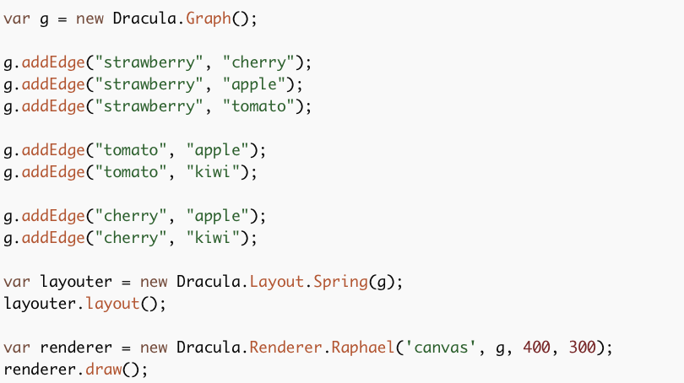
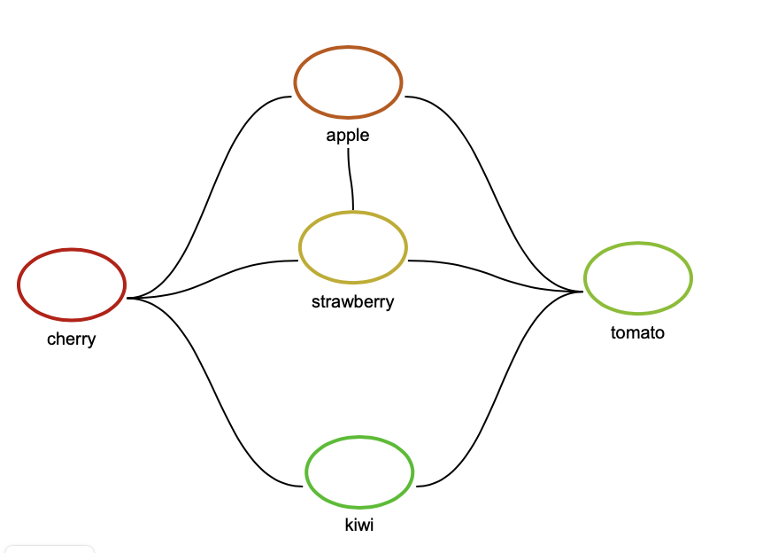
Graduation IN Informatics engineering
■ 2.5- Dracula
Project III
Research only, doesnt apply very well to the Project.
@2020/2021 – Luís Alonso – Flowchart Exploration and Implementation
- 21 -

Slide 22
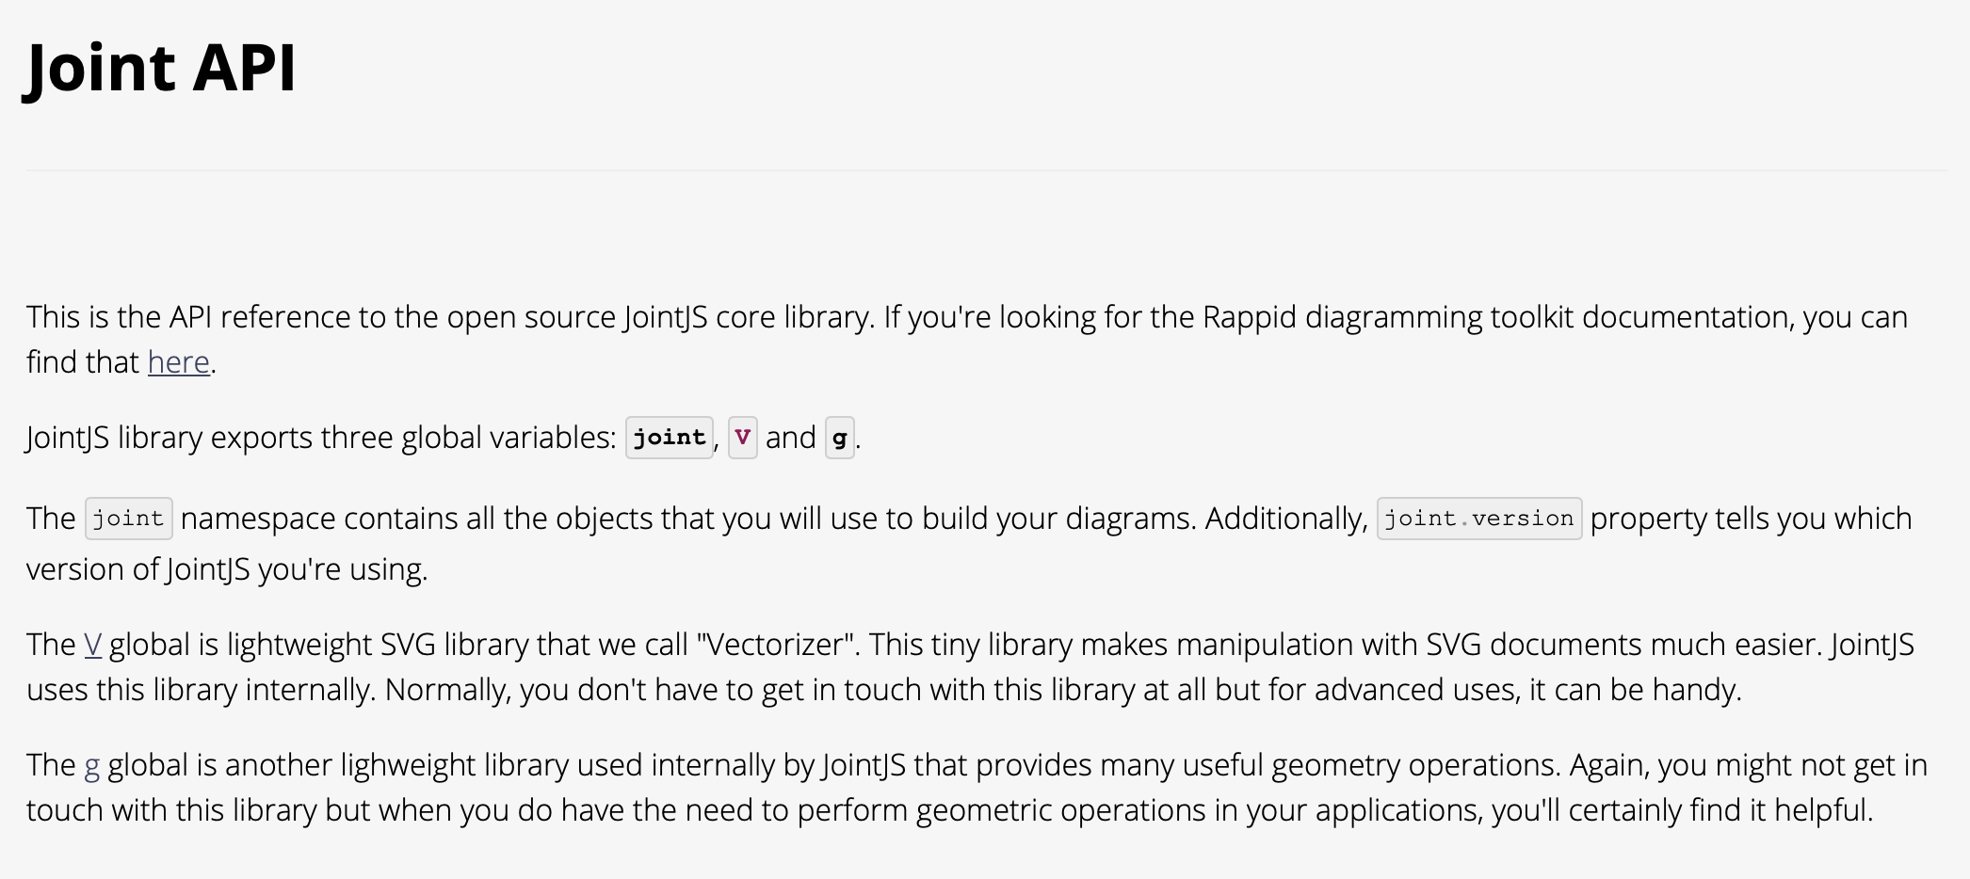
Graduation IN Informatics engineering
■ 2.5- Joint.js
Project III
Joint is the free version of rappid.js, wich is a much advanced/complete library, but it is paid.
@2020/2021 – Luís Alonso – Flowchart Exploration and Implementation
- 22 -

Slide 23
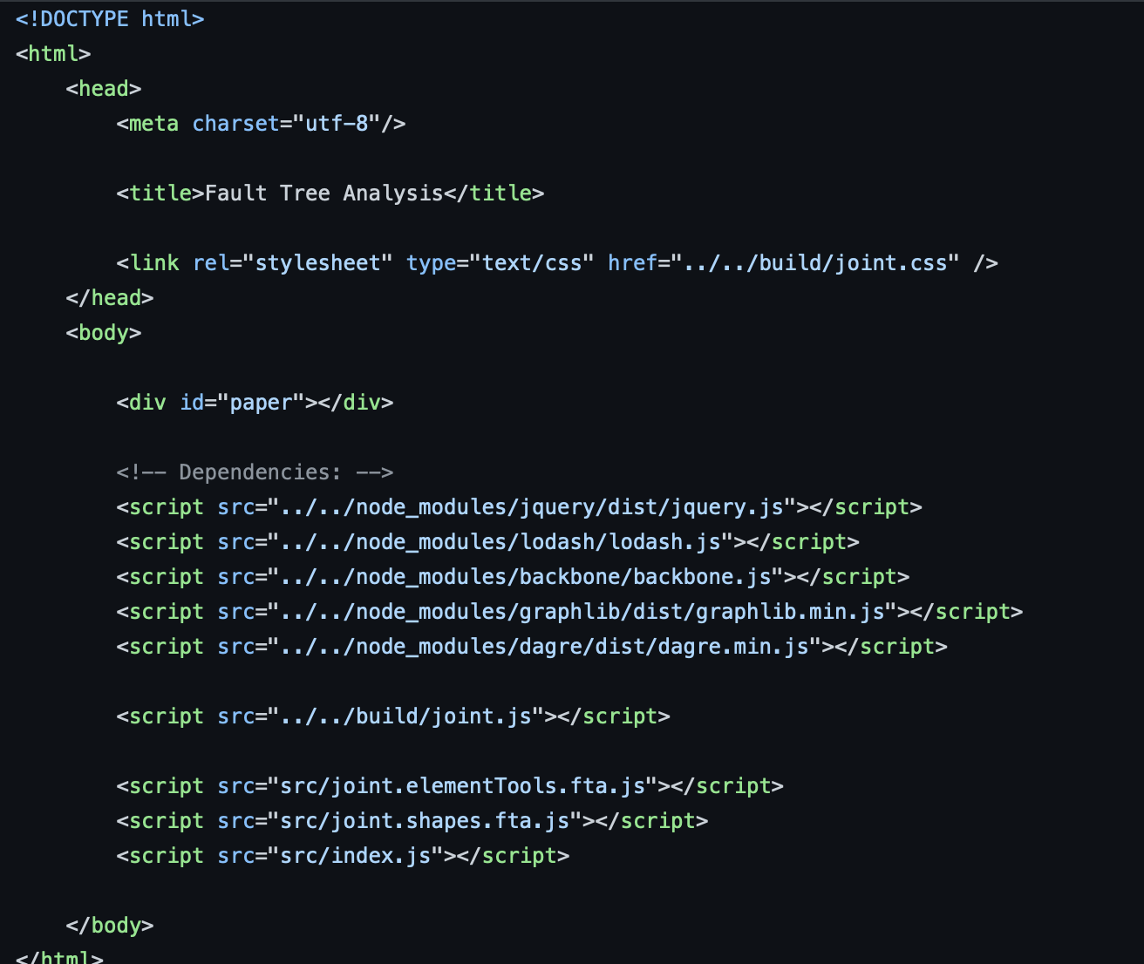
Graduation IN Informatics engineering
■ 2.5- Joint.js
Project III
@2020/2021 – Luís Alonso – Flowchart Exploration and Implementation
- 23 -

Slide 24
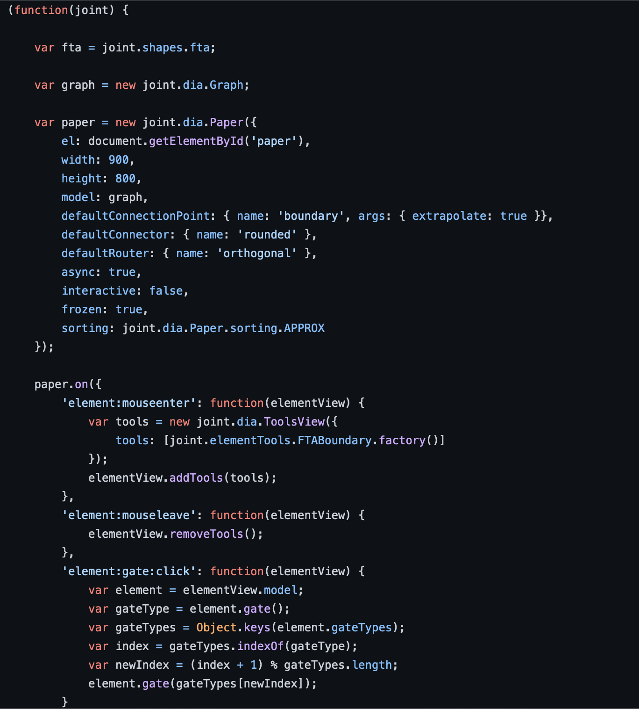
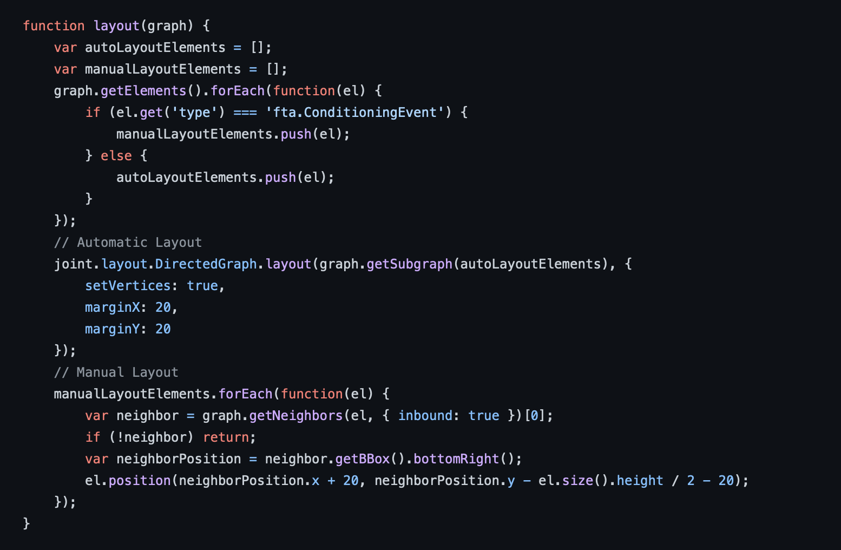
Graduation IN Informatics engineering
■ 2.5- Joint.js
Project III
@2020/2021 – Luís Alonso – Flowchart Exploration and Implementation
- 24 -

Slide 25
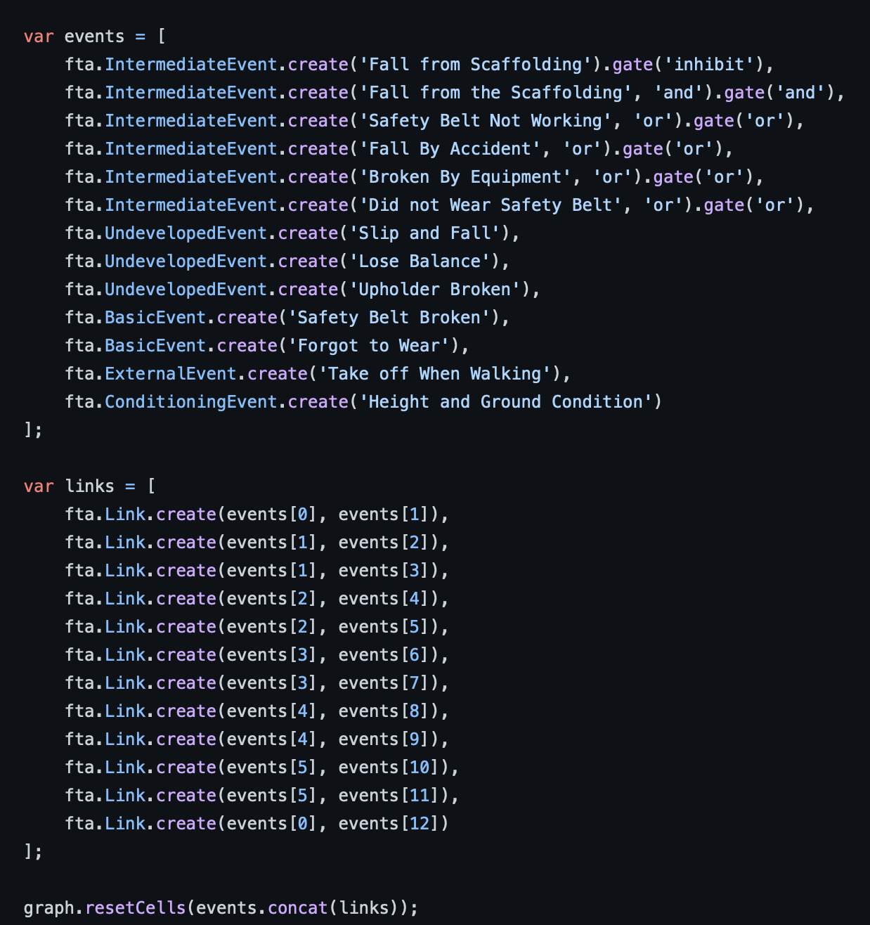
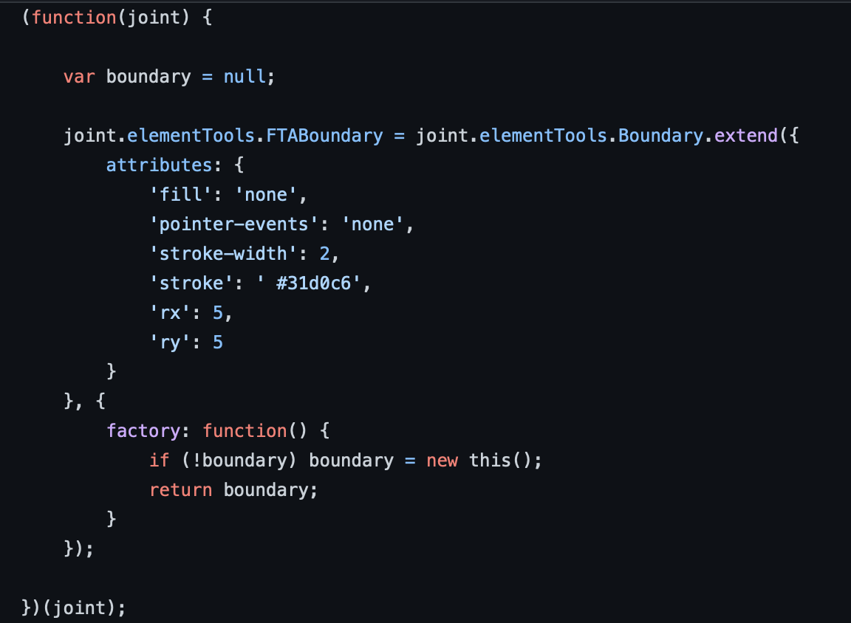
Graduation IN Informatics engineering
■ 2.5- Joint.js
Project III
@2020/2021 – Luís Alonso – Flowchart Exploration and Implementation
- 25 -

Slide 26
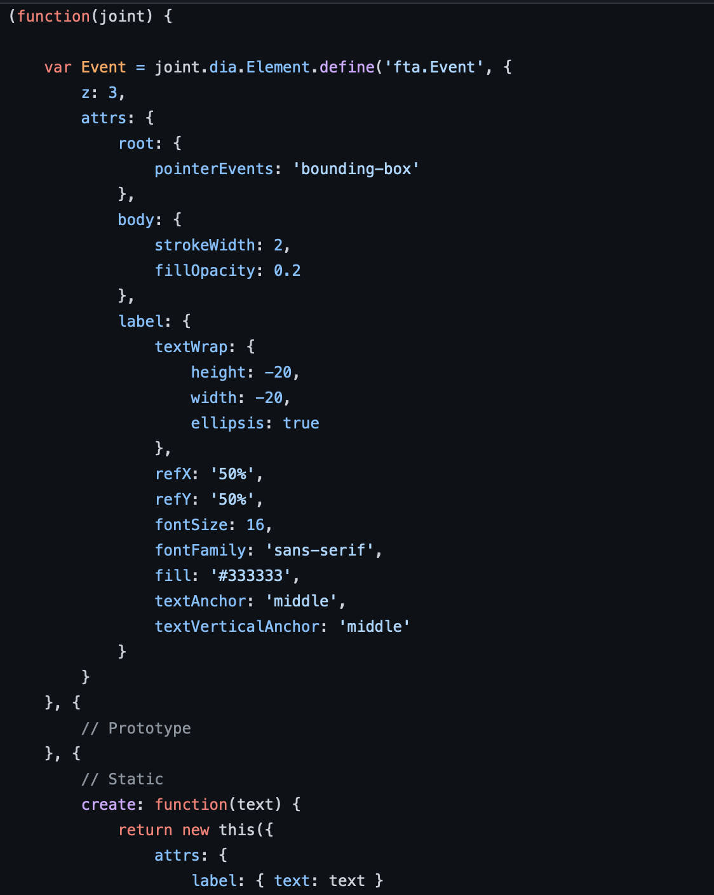
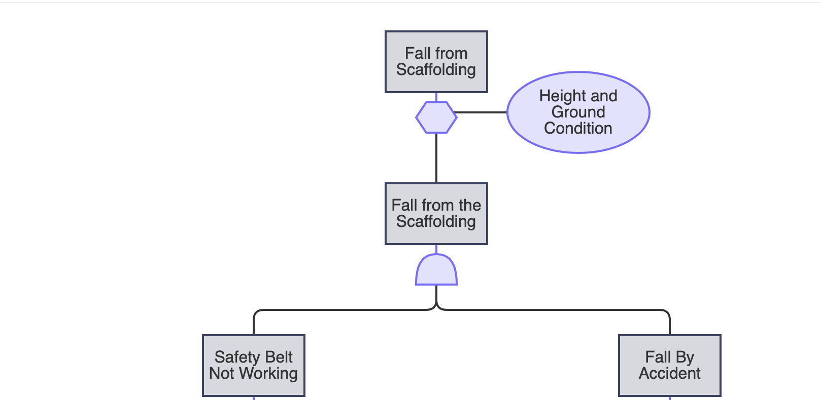
Graduation IN Informatics engineering
■ 2.5- Joint.js
Project III
Official exemple from joint page.
Shape exemple, being this na intermediate event.
@2020/2021 – Luís Alonso – Flowchart Exploration and Implementation
- 26 -

Slide 27
Graduation IN Informatics engineering
Flowchart Exploration and Implementation
■ Course Unit: Project III
Luis Alonso 17506
■ Coordinator: Prof. Doctor Jorge Ribeiro
Instituto Politécnico de Viana do Castelo
Escola Superior de Tecnologia e Gestão
www.ipvc.pt
School Year: 2020/2021

